Slide 1
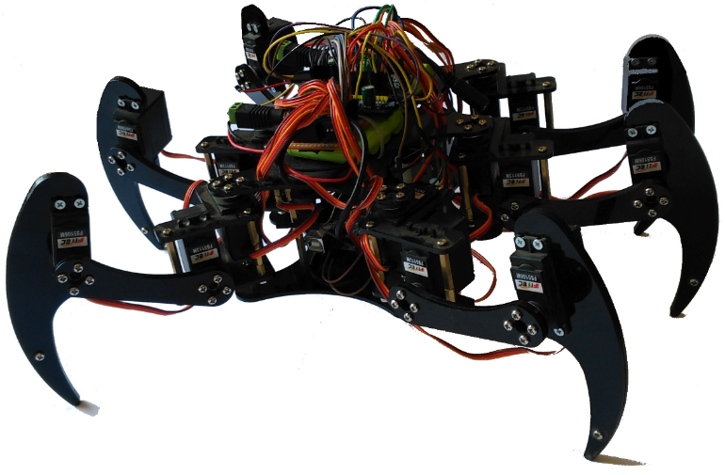

ZagHexa: Design, Construction and Control of a Hexapod Walking Robot
2nd IUGRC International Undergraduate Research Conference,
Military Technical College, Cairo, Egypt, July 24-27, 2017.
Khaled Mohamed Risha | Mahmoud Mohamed Awadallah | Muhammad Alaa Muhammad
khaledrisha@gmail.com | mahmoud.elsyed21@gmail.com | 3bqar10@gmail.com
Amira Elsayed Soliman Fadaly | Hend Khairy Abdelhamed | Nehad Abdelsalam Afifi
amirafadaly90@gmail.com | enghkho@gmail.com | engvida2@gmail.com
Supervisor:
Dr. Ing. Mohammed Nour
mnahmed@eng.zu.edu.eg, https://mnourgwad.github.io

Slide 2
Abstract
18 DOF . 3 DOF each leg . Translate and Rotate . Many possible applications. Robots Operating System (ROS) to be as distributed and modular as possible. Navigation system and a camera for instant video recording and streaming.
This paper describes: The design and control hexapod robot: ZagHexa . Teleoperated robot using hand-held devices. Detect land mines, traverse rocky and unstable terrain and carry out simple delivery missions in danger zones. Exploration of remote locations and hostile environments. Search and rescue operations. The design of the robot and its building subsystems . our approach of how the robot is controlled and localized to provide real-time 3D pose.

Slide 3
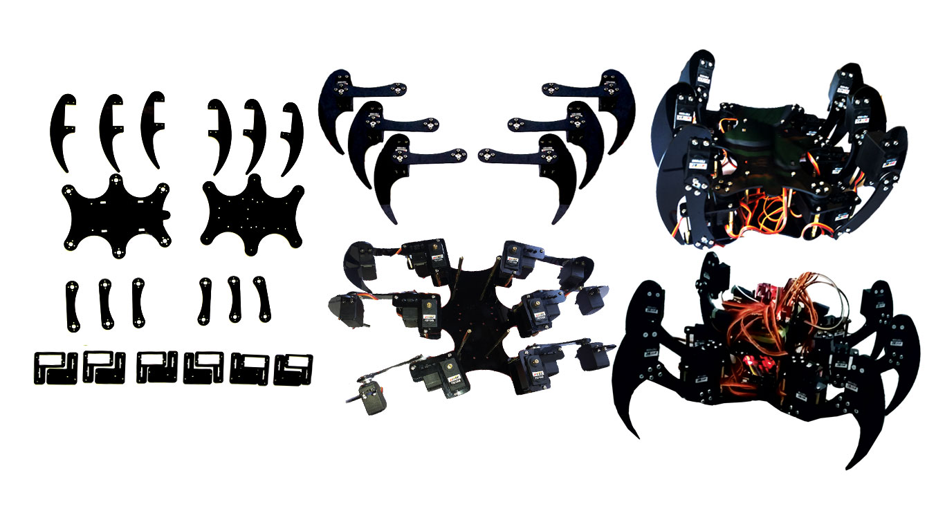
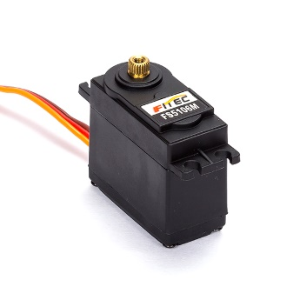
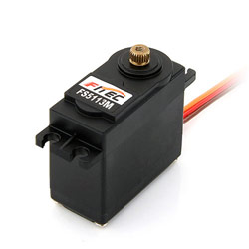
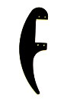
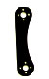

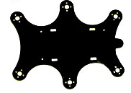
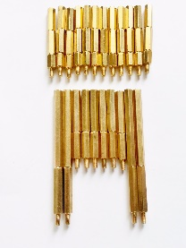
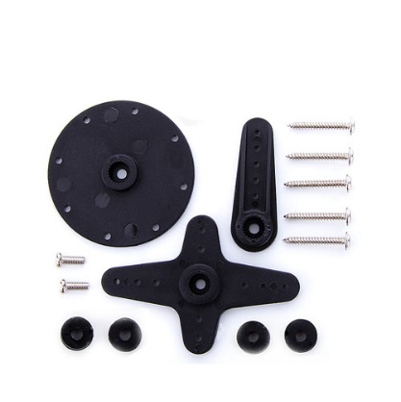
General Mechanical Design
6x Tibia
6x Femur
6x Coxa
2x layer body
Spacers
6x 13KG SV
12x 6KG SV

Slide 4
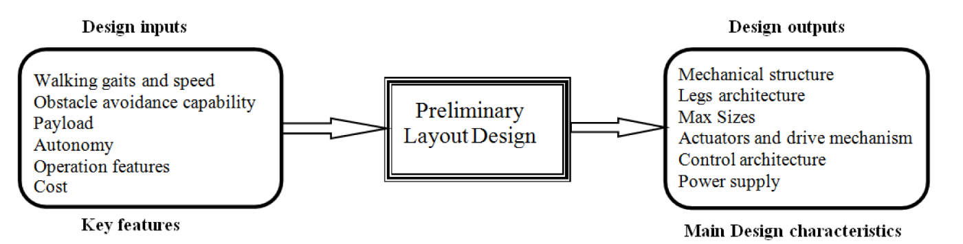
Design Considerations
The mechanical structure of robot body.
Leg architecture.
Max sizes.
Actuators and drive mechanisms.
Control architecture.
Power supply.
Walking gaits and speed.
Obstacle avoidance capability.
Payload.
Autonomy.
Operation features.
Cost.

Slide 5
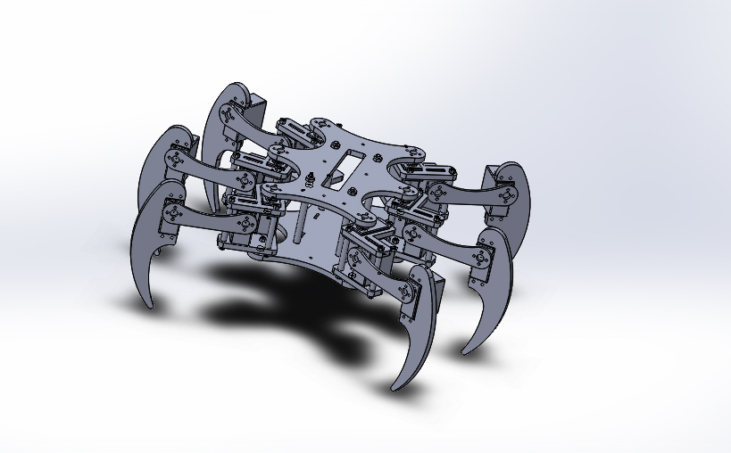
CAD Model
Link of video
Link of the design on the grab cad

Slide 6
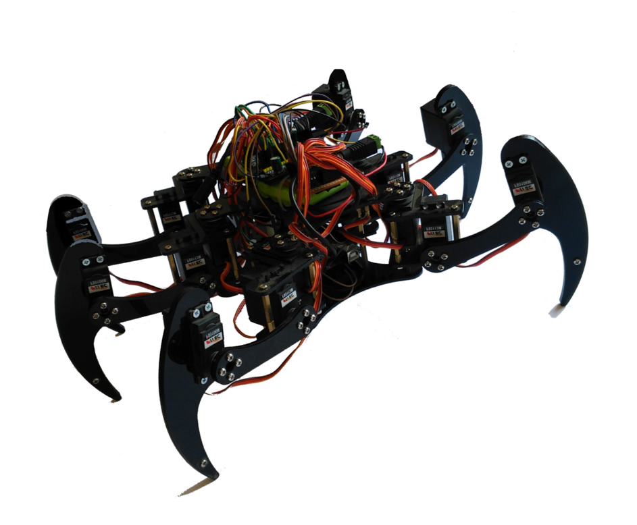
Chassis
ZagHexa
Mini ZagHexa
Micro ZagHexa

Slide 7
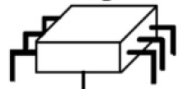
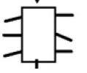
Outline of control systems
User
Robot steering
Feedback display;
posture display
Host
computer
User interface
Task
Task planning
Posture calculation
Gait generation
for trajectory
Leg kinematics calculations
On board
controller
Actuators controls
Sensors acquisitions
Actuators
Sensors

Slide 8
Outline of control systems
User
User interface
Robot steering
Feedback display
posture display
Host Computer
Task planning
Posture calculation
Gait generation
for trajectory
Posture calculation
Leg kinematic calculations
On board
controller
Actuators controls
Sensors acquisitions
Actuators
Sensors

Slide 9



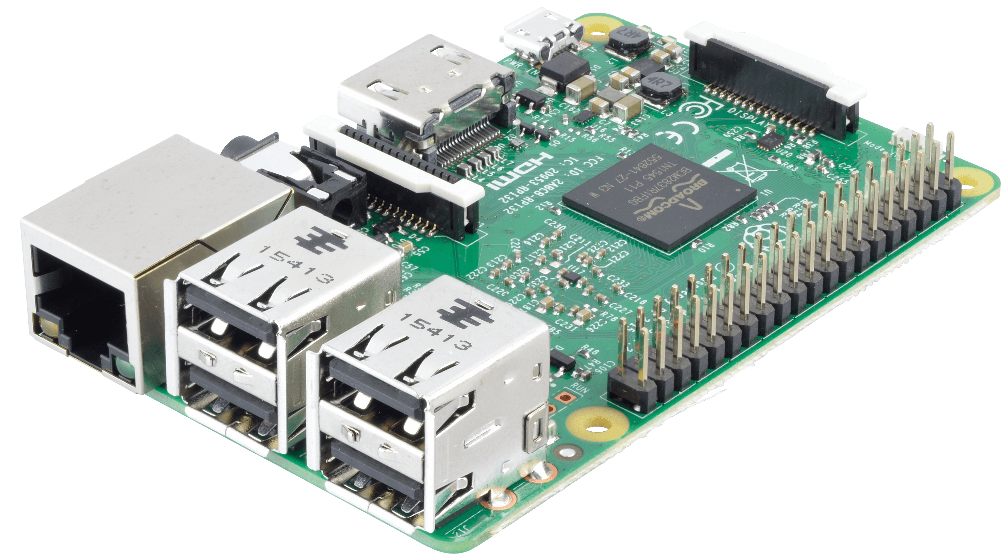


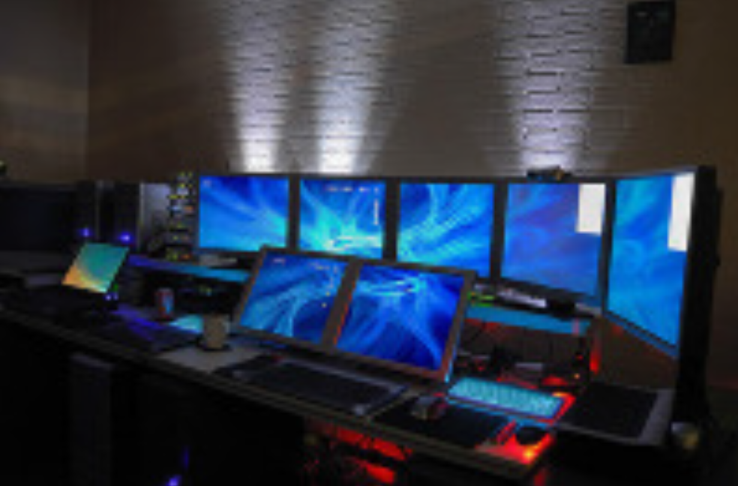

System Design and Control
ZagHexa onboard subsystems
control node
Sensors and camera nodes
Android
Wireless Transmission
Remote Control
GUI, Control & 3D Position Tracker
Android
Operator
Control Station

Slide 10


System Design and Control
GUI, Control & 3D Position Tracker
Wireless
Transmission
Control node
Sensors and camera nodes
Control Station
Operator
Remote Control
ZagHexa onboard subsystems

Slide 11
System Design and Control
Power
PCA9685
Servocontroller
Raspberry pi 3B
Ubuntu
Kinetic Kame ROS
USB
USB
PWM
Wireless
Motors
BT
Camera
Gyro &
Acceler
servos
WiFi
Sensors
Smart
Phones

Slide 12

ZagHexa: System Overview
Mechanical Parameter
 | Dimensions | 30 cm x 27 cm x 17 cm
 | System Mass | ~3kg
 | Velocity | 50 cm/sec on vertical ferrous surfaces
 | Actuation | 2 x 12 V DC gear motors
 | wheels | 2x50 neodymium magnets
On Board Data Handling
 | On Board Computer | gumstix Robovero + AirSTORM COM
Communications
 | W-LAN | 802.11 b/g
 | Remote Control | wireless/WiFi
Power Supply
 | Primary Battery | LiPo: 11.1 V - 800 mAh
 | Bus Voltages | 12V; 5V
 | Average power | 75W (straight driving)
Navigation Sensors
 | sensors | Gyroscope , Accelerometer, Camera
 | Camera | EGO727: IP video camera

Slide 13
ZagHexa Robot (Stage 2)
Technical Data
Weight: 1.2kg
Size: 38 x 28 x 15cm
Speed: 50cm/sec
Battery: 11.1V /800mAh
Autonomy: 30 min
Control: 35MHz
Payload: 2 Cameras, LED

Slide 14
Conclusion
This paper describes: The design and control of a magnetic wall-climbing robot: ZagHexa Robot Remotely operated lightweight robot Hexapods able to detect land mines, traverse rocky and unstable terrain. . The design of the robot and its building subsystems Legged design improves climbing behavior on uneven walls our approach of how the robot is controlled and localized to provide real-time 3D pose.

Slide 15
Future work
Autonomous Robot
Improve ability to climb on rusty surfaces
Further test with localization techniques
Include Computer Vision

Slide 16
Thank you
Computer and System Engineering Dept. Faculty of Engineering,
Zagazig University,
Sharkia, Egypt
Dr. Ing. Mohammed Nour
mnahmed@eng.zu.edu.eg
https://mnourgwad.github.io

